Slide 1
Predicting Diabetes using ANFIS
Harsh Agarwal 18085027
Nitesh Naman Prasad 18085037

Slide 2
Abstract
We studied the ANFIS (Adaptive Network based Fuzzy Inference System) proposed by Jang(1993). We implemented a simple version of ANFIS for Diabetes predictor with Gaussian membership functions and tuned it. Our model had a test accuracy of 81.30%, train accuracy of 85.42%, test F1-Score of 74.72% and test F1-Score of 78.44%. We further analysed the variation of performance metrics and losses with epochs, constructed the confusion matrix, plotted graph of the membership functions learnt by the model and discussed our observations.

Slide 3
Introduction
In the recent times, due to availability of large amount of data and high computational power, Artificial Intelligence (AI) and Machine Learning (ML) algorithms play a very important role in automation. In today’s world models have been trained rigorously and have achieved high accuracy. But a feature used for classification cannot be a crisp value exactly, i.e., there is some amount of fuzziness involved. To account for this, we use membership function to estimate the relatedness of an element to a set. This feature plays a very important role in identifying unclear examples in the dataset. Fuzzy neural networks (FNN) combine the Fuzzy Logic and Neural networks in single model. We study Adaptive-Network-based Fuzzy Inference System (ANFIS) (Jang, 1993) and implement a model to that predicts whether a person is having diabetes or not.

Slide 4
Model

Slide 5
Architecture and Equations for Forward Pass
The main advantage of Adaptive Network based Fuzzy Inference System over other inference system is that the parameters used for its membership functions can be changed. Hence we can apply Machine Learning (ML) algorithms to train these parameters and build a model that fits into the given dataset. Moreover, ANFIS can be stacked with any other Deep Learning models, which makes it more interesting to study and unique from other Fuzzy Neural Networks
ANFIS is made up of five layers as discussed in the following subsections.

Slide 6
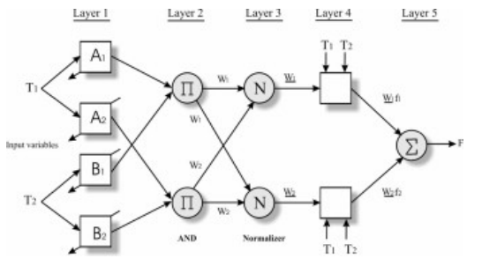
Architecture of ANFIS

Slide 7
Input Layer
This contains the input features of the data used by the model. The data has to be standardised before it is being fed to the model. Mathematically, our input data will be a n dimensional vector for each example (data point).
For n input features x_{i} (i = 1, 2, . . . , n),
Input: x₁, x₂, . . . , x_{n}
Output: x₁, x₂, . . . , x_{n}

Slide 8
Fuzzification Layer
This layer is made up of mn nodes (where m is the desired number of fuzzy rules and n is the number of input features). For every input feature i, (i = 1, 2, . . . , n) there are nodes a_{ij} where j = 1, 2, . . . , m. A Gaussian membership function with trainable parameters µ (mean) and σ² (variance), is applied to the input features to obtain the output for this layer.
For each node a_{ij} where i = 1, 2, . . . , n and j = 1, 2, . . . , m
Input: x_{i}
Output: N_{i1}(x_{i}), N_{i2}(x_{i}), ......N_{im}(x_{i})
where N_{ij} is the Gaussian membership function with mean µ_{ij} and variance σ²_{ij} .

Slide 9
Rule Layer
This layer takes the product (algebraic intersection, ∩_{a}) of the respective rules obtained in the previous layer. The output of this layer is fed as input for the next layer.
Each node a_{j} in this layer, takes x_{1j} , x_{2j} ......x_{nj} from the previous layer, where n is the number of features and j = 1, 2, . . . , m, where m is the number of fuzzy rules. It gives product of all these values, i.e., a_{j} = Π ^{n}_{i=1} x_{ij} , as the output which is then normalised.
For each node j (j = 1, 2, . . . , m),
Input: w_{1j} , w_{2j} , . . . , w_{nj}
w_{j} = w_{1j} · w_{2j} · · · w_{nj}
sum = w₁ + w₂ + · · · + w_{m}
Output: w_{j}∗ = w_{j}/sum. Here, w_{j}∗ is the normalized weight.

Slide 10
De-fuzzification layer
It has m nodes which is the number of fuzzy rules. As the name says, this layer is used for defuzzification. Each node takes the corresponding previous node output and the input layer values and does the following (a₀ +a₁x₁ +a₂x₂ +· · ·+a_{n}x_{n}).w where w is the weight of the corresponding rule layer and a₀, a₁, a₂, . . . , a_{n} are trainable parameters.
For each j (j = 1, 2, . . . , m),
Input: f_{j} = a_{0j} + a_{1j}x₁ + · · · + a_{nj}x_{n}
Output: w_{j}∗ f_{j} .
where a₀, a₁, . . . , a_{n} are trainable parameters.

Slide 11
Output layer
All the outputs from previous layer is added and an activation function (sigmoid function, in our case) is applied.
For each j (j = 1, 2, . . . , m)
Input: X = ∑ ^{m}_{j=1} w_{j}∗ f_{j} .
Output: σ(X)
where σ(x) = 1/(1+e^{−x}) is the sigmoid function. If x > 0, σ(x) > 0.5, so we assign a label 1 to such an input (and 0 otherwise).

Slide 12

2. Membership Functions
Gaussian membership function is the widely used membership function. Yet, other membership functions like Generalized Bell membership function, Triangular fuzzy number, Trapezoidal fuzzy number, etc., can also be applied. However, it is recommended to choose a function with smooth curves, so that they are differentiable (helpful for optimizer while training), and it also helps us to learn nonlinear functions. Given below is Gaussian Membership Function we used in the Fuzzification Layer,
where µ is the mean and σ² is the variance.

Slide 13
Experiment

Slide 14
Dataset
Feature | Short Description
Pregnancies | Number of times pregnant
Blood Pressure | Plasma glucose concentration a 2 hours in an oral glucose tolerance test
Blood Pressure | Diastolic blood pressure (mm Hg)
Skin Thickness | Triceps skin fold thickness (mm)
Insulin | 2-hour serum insulin (mu U/ml)
BMI | Body mass index (weight in kg/(height in m)2 )
Diabetes Pedigree Function | Diabetes pedigree function
Age | Age (years)
Outcome | Class variable (0 or 1)
We use the ”Pima Indians Diabetes Database” from Kaggle. The dataset contains 768 examples and 8 features (plus one outcome). It is worthy to note that this dataset only consists of females who are at least 21 years old.

Slide 15
Pre-processing
We split the dataset into train and test data using sklearn.model_selection.train_test_split(). The model requires each feature to have a mean 0 and standard deviation 1. Hence, we standardize each column of the dataset before using it.
It was observed that the dataset did not have any missing data-so no additional processing were necessary.

Slide 16
Settings
We used sklearn.model_selection.train_test_split() with test_split() set to 0.16. Moreover, random_state was set to 2021.
Total number of fuzzy rules used in the model was set to 14.
Binary Cross Entropy was the loss function used.
Adam Optimizer was used with learning parameter α = 0.01 to optimize the loss function in 1000 epochs.
Data points for plotting graphs were taken at every 10 epochs.
Gaussian membership function was used for each fuzzy rule. The weights, µ, σ were randomly initialized from normal distribution.
We omit the Pregnancies column from the dataset, as it doesn’t have a direct relation with the disease of interest.
We conducted our experiment with the following hyperparameters:

Slide 17




Results
Now, we define the performance metrics of our interest.
We use the following notations to define the performance metrics we use in this report:
TP (True Positive): Model predicts Positive and it is actually Positive.
FP (False Positive): Model predicts Positive but it is actually Negative.
FN (False Negative): Model predicts Negative but it is actually Positive.
TN (True Negative): Model predicts Negative and it is actually Negative.

Slide 18
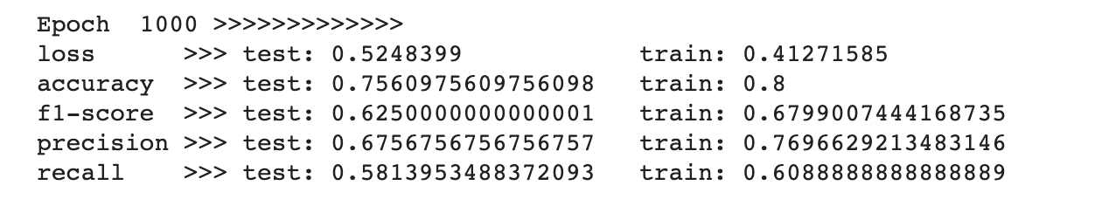
The Performance and losses of model on train and test set is given in below table :
 | Test | Train
Accuracy | 75.61% | 80.00%
Precision | 67.56% | 76.96%
Recall | 58.13% | 67.99%
F1-Score | 62.51% | 67.99%
Loss | 0.5248 | 0.4127

Slide 19
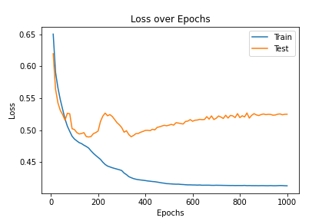

Slide 20
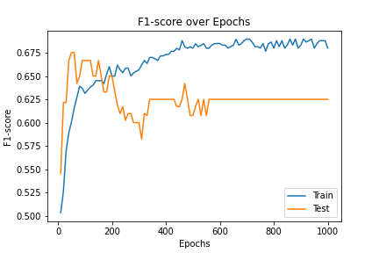
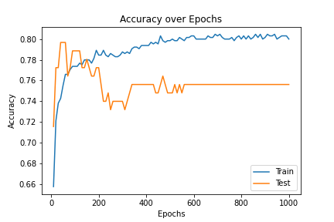
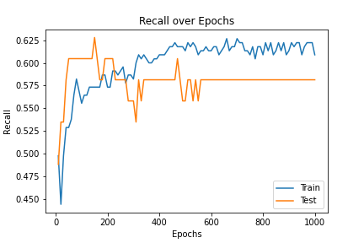
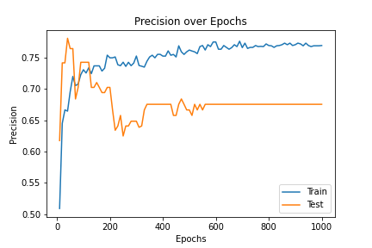
Performance Metrics:

